Slide 1
Webinar: OGC API – Maps Sprint
Standard draft status.
Joan Masó
July, 2020
#OGCAPI

Slide 2
Some rules of the game
We are trying to make reusable building blocks
The core defines how to get a map (or a tile) of everything (or nothing)
Other extensions define how to use the building block in concrete situations
We are trying to make reusable building blocks for non-OGC APIs
We do not define a mandatory dependency on common but we use it extensibility in the standards.
We are using the modular specification
Each building block is a requirements class
And there are many!!

Slide 3
What is a map (informal def)
It is data that has a style applied and can be requested by sub-setting the space (a.k.a. partitioning)
You have resources that become maps by applying "…/map"
This endpoint represents the map and will give you info about the map and how to formulate a request to a subset of it and the STYLES that can be applied
"…/map/{styleId}" is the endpoint to get a subset.
Using the tiles API: "…/map/{styleId}/tiles/{tileMatrixSetId}/…/{tileCol}"
Using the BBOX extension: "…/map/{styleId}?crs=ccc&bbox=bbb&width…

Slide 4
Modular approach
Tiles Part 1: core
Tiles Part 2: maps
Maps Part 1: core
Map-tilesets
Maps Part 2: partition
Common GeoData
Maps BBox
Common core
Map res. (style)
Tileset
Notes:
/collections/{collectionId}/time/20201213/elevation/123/map/{styleId}/{crsId}?bbox=width=height=
/collections/{collectionId}/map/{styleId}?crs=bbox=width=height=
/collections/{collectionId}/map/{styleId}/tiles "Requerir que tots els estils es tallin igual."
/collections/{collectionId}/tiles
/time/20201213/elevation/123/dim_band/3/map/{styleId}/{crsId}?bbox=width=height=
/map/{styleId}/tiles

Slide 5
Modular approach
Data Tiles
(incl. Vector Tiles)
Map Tiles
Maps
Tiles Part 1: core
Tiles Part 2: maps
Maps Part 1: core
Map-tilesets
Maps Part 2: partition
Common GeoData
Maps BBox
Common core
Map res. (style)
Tileset
Notes:
/collections/{collectionId}/time/20201213/elevation/123/map/{styleId}/{crsId}?bbox=width=height=
/collections/{collectionId}/map/{styleId}?crs=bbox=width=height=
/collections/{collectionId}/map/{styleId}/tiles "Requerir que tots els estils es tallin igual."
/collections/{collectionId}/tiles
/time/20201213/elevation/123/dim_band/3/map/{styleId}/{crsId}?bbox=width=height=
/map/{styleId}/tiles

Slide 6
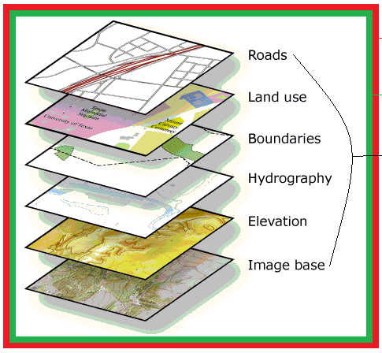
What resources can I transform into a map?
Be aware that an OGC API represents ONE dataset
This gives us "continuity" with the STAC spec that is an specification that gives access to a dataset.
What is a dataset?. Do not get stack with it!. It what you want it to be as far as
It is data managed by one institution (or a consortium)
It can be accessed via geospatial data resources (e.g. collections)
We can get a map for the whole dataset. The landing page (root) is the dataset
Using the tiles API: "/map/{styleId}/tiles/{tileMatrixSetId}/…/{tileCol}"
Using the BBOX extension: "/map/{styleId}?crs=ccc&bbox=bbb&width…
Notes:
https://developers.arcgis.com/net/10-2/store/api-reference/html/65a3c0ed-425b-4ae2-b97e-a17d4cd29e98.htm

Slide 7
Modular approach
Data Tiles
(incl. Vector Tiles)
Map Tiles
Maps
Tiles Part 1: core
Tiles Part 2: maps
Maps Part 1: core
Map-tilesets
Maps Part 2: partition
Common GeoData
Maps BBox
Dataset-tilesets
Dataset-map
Common core
Map res. (style)
Tileset
Notes:
/collections/{collectionId}/time/20201213/elevation/123/map/{styleId}/{crsId}?bbox=width=height=
/collections/{collectionId}/map/{styleId}?crs=bbox=width=height=
/collections/{collectionId}/map/{styleId}/tiles "Requerir que tots els estils es tallin igual."
/collections/{collectionId}/tiles
/time/20201213/elevation/123/dim_band/3/map/{styleId}/{crsId}?bbox=width=height=
/map/{styleId}/tiles

Slide 8
Do I have to get the whole dataset back?
We can get a map for the whole dataset.
But we can also filter by geospatial data resources
"map/{styleId}?geodata=boundaries,roads"

Slide 9
Modular approach
Data Tiles
(incl. Vector Tiles)
Map Tiles
Maps
Tiles Part 1: core
Tiles Part 2: maps
Maps Part 1: core
Map-tilesets
Maps Part 2: partition
Common GeoData
Maps BBox
Dataset-tilesets
Dataset-map
Common core
Map res. (style)
Tileset
Part 0: layers
GeoData-selection
Notes:
/collections/{collectionId}/time/20201213/elevation/123/map/{styleId}/{crsId}?bbox=width=height=
/collections/{collectionId}/map/{styleId}?crs=bbox=width=height=
/collections/{collectionId}/map/{styleId}/tiles "Requerir que tots els estils es tallin igual."
/collections/{collectionId}/tiles
/time/20201213/elevation/123/dim_band/3/map/{styleId}/{crsId}?bbox=width=height=
/map/{styleId}/tiles

Slide 10
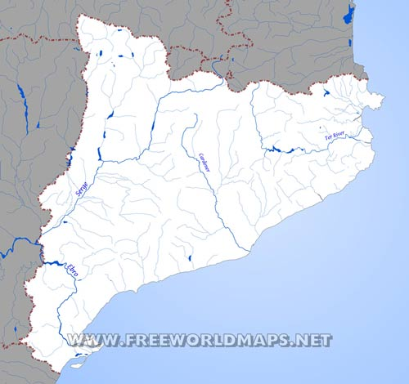
Do I have to get the whole dataset back?
We can also filter by geospatial data resources
Or we can convert a collection in a map
Using the tiles API: "/collections/hydrography/map/{styleId}/tiles/{tileMatrixSetId}/…/{tileCol}"
Using the BBOX extension: ""/collections/hydrography//map/{styleId}?crs=ccc&bbox=bbb&width…

Slide 11
Modular approach
Data Tiles
(incl. Vector Tiles)
Map Tiles
Maps
Tiles Part 1: core
Tiles Part 2: maps
Maps Part 1: core
GeoData-tilesets
Map-tilesets
GeoData-map
Maps Part 2: partition
Common GeoData
Maps BBox
Dataset-tilesets
Dataset-map
Tiles Part 3:
more TMXS
Tiles TMXS
Common core
Map res. (style)
Tileset
Part 0: layers
GeoData-selection
Notes:
/collections/{collectionId}/time/20201213/elevation/123/map/{styleId}/{crsId}?bbox=width=height=
/collections/{collectionId}/map/{styleId}?crs=bbox=width=height=
/collections/{collectionId}/map/{styleId}/tiles "Requerir que tots els estils es tallin igual."
/collections/{collectionId}/tiles
/time/20201213/elevation/123/dim_band/3/map/{styleId}/{crsId}?bbox=width=height=
/map/{styleId}/tiles

Slide 12
What about GetFeatureInfo?
Adding a /info at the end of a map box subset or a tile subset you will get information about a coordinate or about an area etc
This has not been specified yet but is somebody is interested we could to it in the Sprint.

Slide 13
Modular approach
Data Tiles
(incl. Vector Tiles)
Map Tiles
Maps
Tiles Part 4: info
Maps Part 3: info
Tiles info
Maps Info
Tiles Part 1: core
Tiles Part 2: maps
Maps Part 1: core
GeoData-tilesets
Map-tilesets
GeoData-map
Maps Part 2: partition
Common GeoData
Maps BBox
Dataset-tilesets
Dataset-map
Tiles Part 3:
more TMXS
Tiles TMXS
Common core
Map res. (style)
Tileset
Part 0: layers
GeoData-selection
Notes:
/collections/{collectionId}/time/20201213/elevation/123/map/{styleId}/{crsId}?bbox=width=height=
/collections/{collectionId}/map/{styleId}?crs=bbox=width=height=
/collections/{collectionId}/map/{styleId}/tiles "Requerir que tots els estils es tallin igual."
/collections/{collectionId}/tiles
/time/20201213/elevation/123/dim_band/3/map/{styleId}/{crsId}?bbox=width=height=
/map/{styleId}/tiles

Slide 14
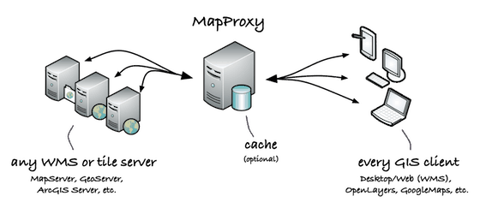

How to recycle a WMS service
The new OGC API Maps reproduces equivalent functionality that we had in WMS but with a different syntax.
If you have a WMS implementation you can build a facade on top of your implementation
Facade
OGC API Client

Slide 15
WMS Server to OGC API Maps (1/3)
Your WMS layers becomes your collections
In /collections
Return the description of your layers one by one (HTML & JSON)
In /collections/{collectionId}
Return the description of your layer (HTML & JSON)
Include /collections/{collectionId}/map in the list of links
In /collections/{collectionId}/map
List your supported CRSs and styles for this layer (and some links) HTML & JSON
In /map
Return a list your supported CRSs and styles for all layers (and some links) (HTML & JSON)

Slide 16
WMS server to OGC API Maps (2/3)
In /collections/{collectionId}/map/{styleId}?
Read CRS=, BBOX=, WIDTH=, HEIGHT=, TRANPARENT= as if they where WMS parameters
Expect CRS to by a full URI to a CRS.
The format is in the Content-Type HTTP header (or in a f= parameter)
Create and return the map in the requested format
Consider supporting HTML with a full blow map client (e.g. leaflet)
In /map/{styleId}
Read CRS=, BBOX=…
Read GEODATA= as it was the LAYERS parameter (if it is not there assume all)
Transform {styleId} in a comma separated list of WMS styles
Create and return the overlaid map in the requested format

Slide 17
WMS server to OGC API Common (3/3)
WARNING: this slide contains boring stuff but it has to be done to improve interoperability
/ (landing page):
Return links to conformance, collections and dataset map HTML & JSON
Consider to use some of the GetCapabilities info as schema.org microdata (for the HTML)
/conformance
Return the list the conformance classes URIs (JSON)
/api
Return a description of your API in the Open API language listing your paths and parameters (JSON, YAML and HTML(use swagger libs) )
Some GetCapabilities information can be reused here.

Slide 18
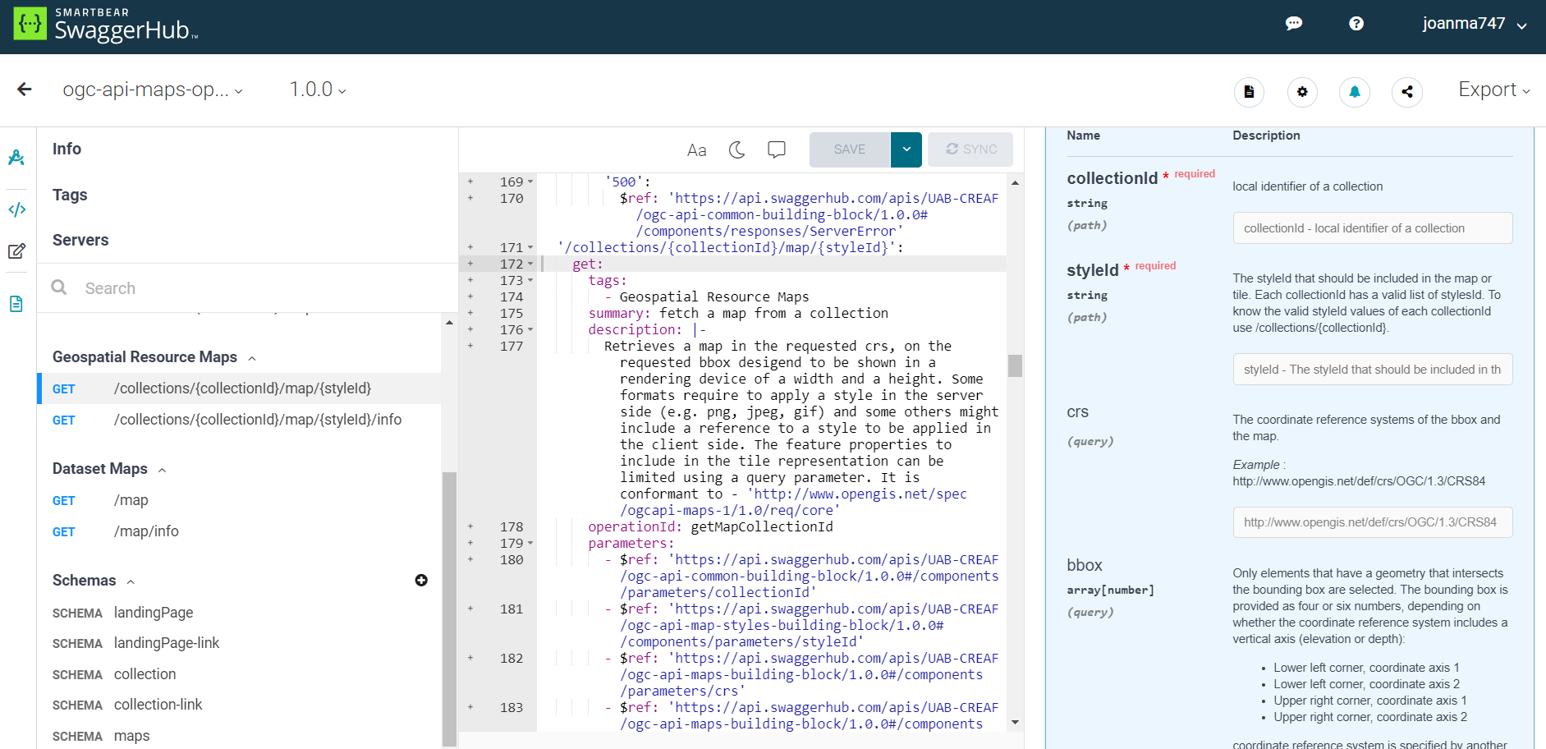
OpenAPI to describe web services API

Slide 19
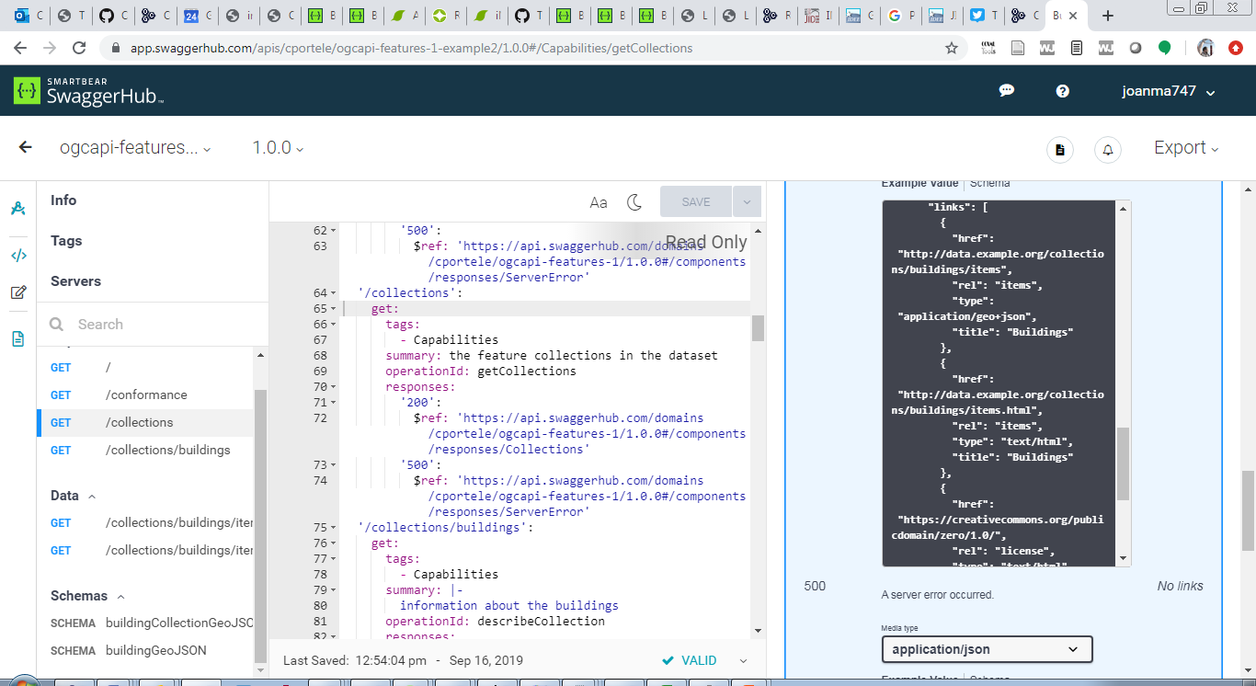
Linking everything
Direct access to paths
Follow the links

Slide 20
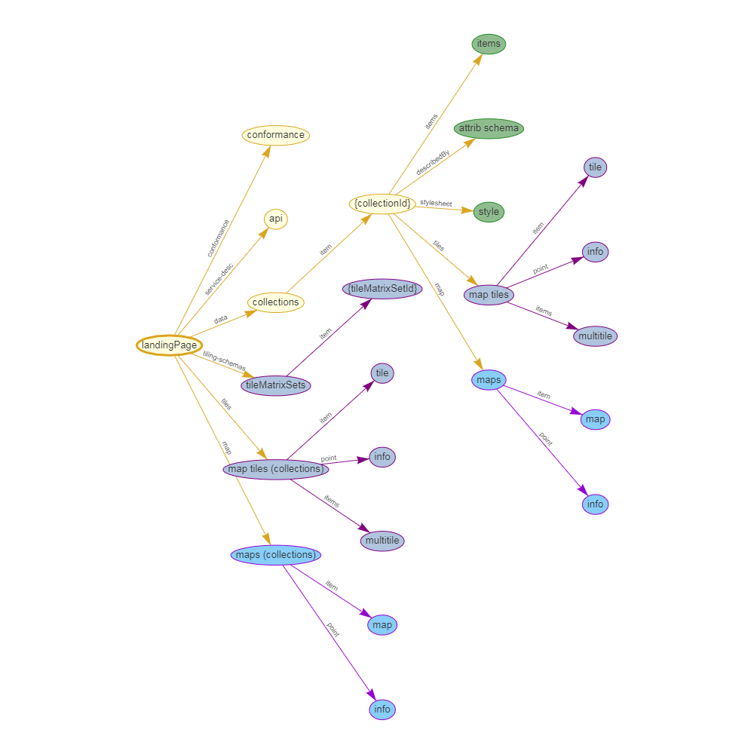
Follow the links
Old illustation. Needs review
(collections: more that one collection)

Slide 21
Community
500+ International Members
110+ Member Meetings
60+ Alliance and Liaison partners
50+ Standards Working Groups
45+ Domain Working Groups
25+ Years of Not for Profit Work 10+ Regional and Country Forums
Innovation
120+ Innovation Initiatives
380+ Technical reports
Quarterly Tech Trends monitoring
Standards
65+ Adopted Standards
300+ products with 1000+ certified implementations
1,700,000+ Operational Data Sets Using OGC Standards
Contact info@ogc.org to schedule a meeting for an in-depth discussion with OGC staff and join our community today!
Notes:
If you have any questions, do not hesitate to reach out to OGC or schedule a follow-up. We’re working constantly to change the landscape of location information and want to help your organization get where it needs to go.

